Slide 1
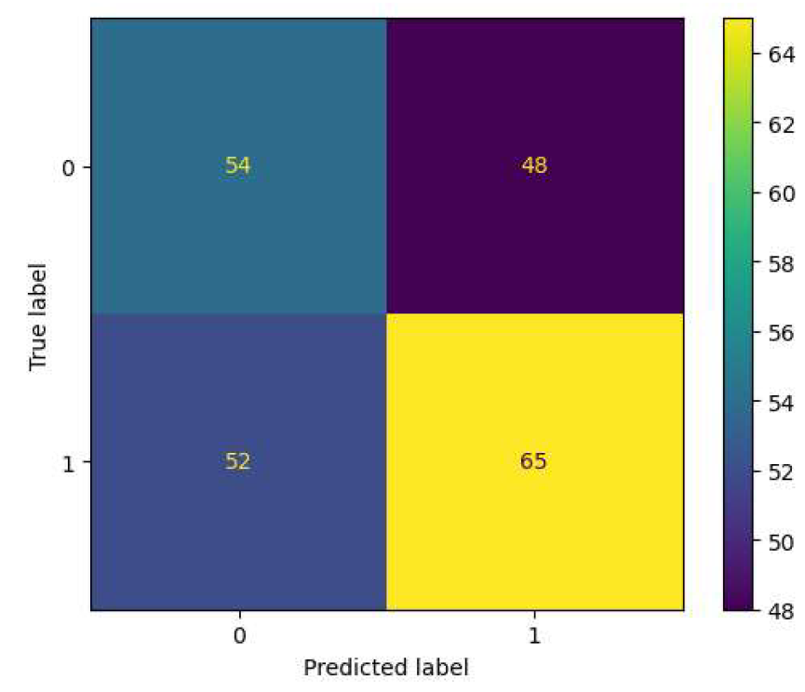
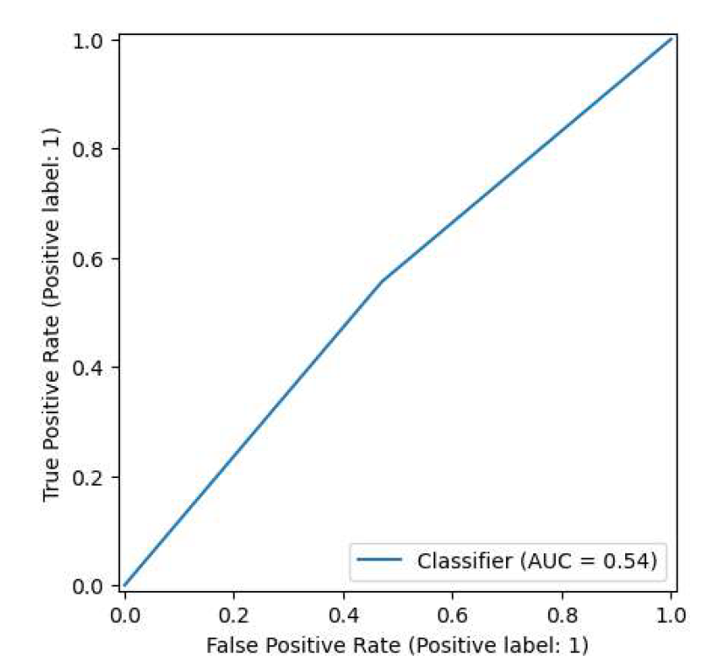
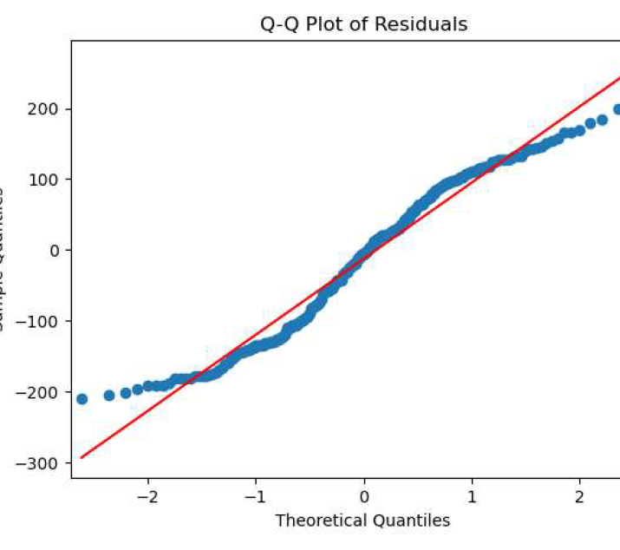
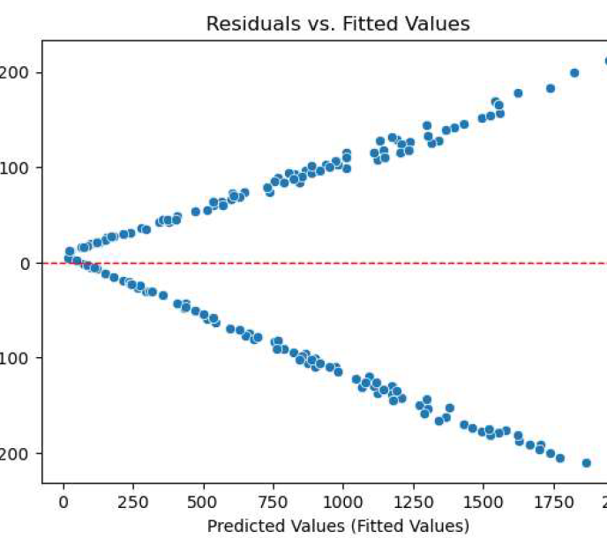
Coffee Bean Sales Project Data Summary
The final Executive report and next steps
Project Overview
Seungsoon conducted a detailed analysis of coffee bean sales data in Saudi Arabia, identifying key variables and uncovering meaningful trends to provide actionable insights for the client.
An analysis was conducted to evaluate the impact of discounts on quantity and sales. However, it was not possible to construct a reliable model with the given variables, as the results showed a low AUC score and poor performance metrics, including accuracy, recall, and precision, all around 0.55
The multivariate linear regression model, incorporating two variables—quantity and sales amount—was developed to predict final sales. Although the model achieved a high R-squared value of 0.95, it failed to satisfy key assumptions, particularly linearity
Image Alt-Text Here
Acquire additional data and broaden the scope of data collection by utilizing more assets to strengthen the analysis and improve model development.

